Slide 1

Sales Performance Data Pipeline
By: Deana Moghaddas

Slide 2

Data Pipeline Overview
Establish connection between RStudio and PostGreSQL database.
Load CSVs into database and store into preliminary data tables: customers, products, and orders.
Create intermediate datasets: dim_customer and dim_product
Use Create Table statements to define variables, types and constraints
Set maximum lengths dynamically using preliminary data tables; set primary keys to ensure uniqueness
Insert data into tables and take the following processing steps, using customers and products respectively:
Remove all whitespaces from ID variables, and remove trailing /leading spaces for remaining VARCHAR variables
Convert VARCHAR variables to uppercase for consistency. If VARCHAR variables are empty strings, set NULL.
Remove rows with primary keys containing NULL or NA since they cannot be used to join
Set all invalid dates to NA
Create intermediate dataset: fact_sales
Left join dim_customer and dim_product on foreign keys to orders. Repeat above processing steps for remaining variables.
Set numeric variables to 0 when NULL
Create final dataset: sales_performance
Using fact_sales, extract month from order_date variable. Aggregate revenue and group by month, customer and product.
Result: each row shows revenue generated from an individual customer on a certain product, within the month

Slide 3
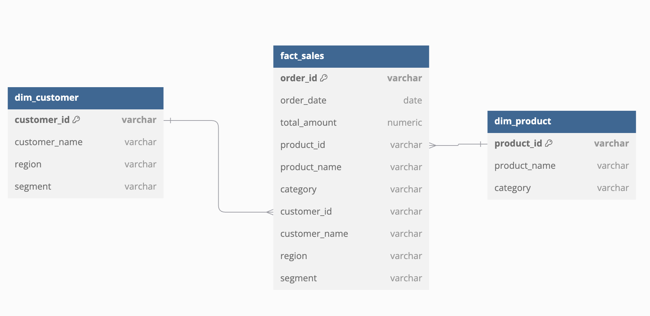
Database Schema
Notes:
The table dim_customer contains customer information; specifically, this table contains unique customers (determined by variable customer_id) and their name, region and segment.
The table dim_product contains product information, containing unique products (determined by variable product_id) and the product’s name name, as well as the category it belongs to.
The table fact_sales includes order information, and contains foreign keys customer_id and product_id that are used to append customer and product information from tables dim_customer and dim_product. Therefore, fact_sales contains unique order information (determined by variable order_id), including the order date and money spent, as well as information about the customer buying the order and the product being ordered.

Slide 4
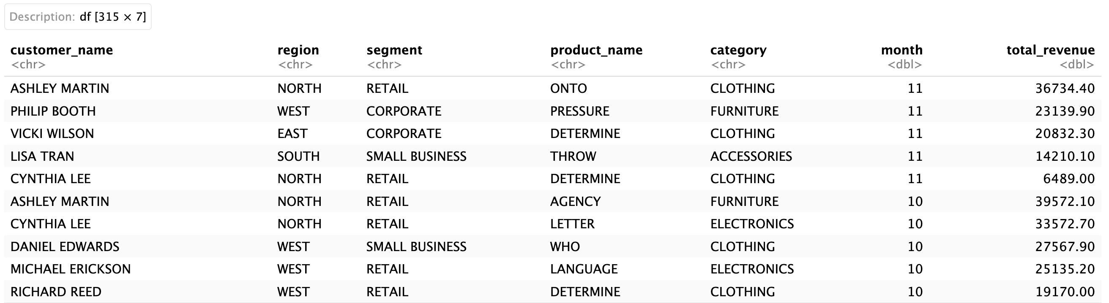
Final Table and Use Cases
What does final table show?
Each row shows revenue generated from an individual customer on a certain product, within the month
Use Cases within Tableau Dashboard (Graph, Chart, Table, etc.):
Total revenue, revenue by product, revenue by month, revenue by region
Top-performing products and customers, generating most revenue
Top-performing products per segment
Characteristics of customers most likely to make a purchase, and frequency of those purchases
Example: 10 rows from sales_performance

